Slide 1

AgriTech IoT
By Team Insight
In Collaboration with Centre for Technology Infusion

Slide 2

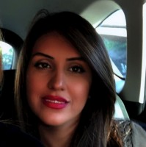
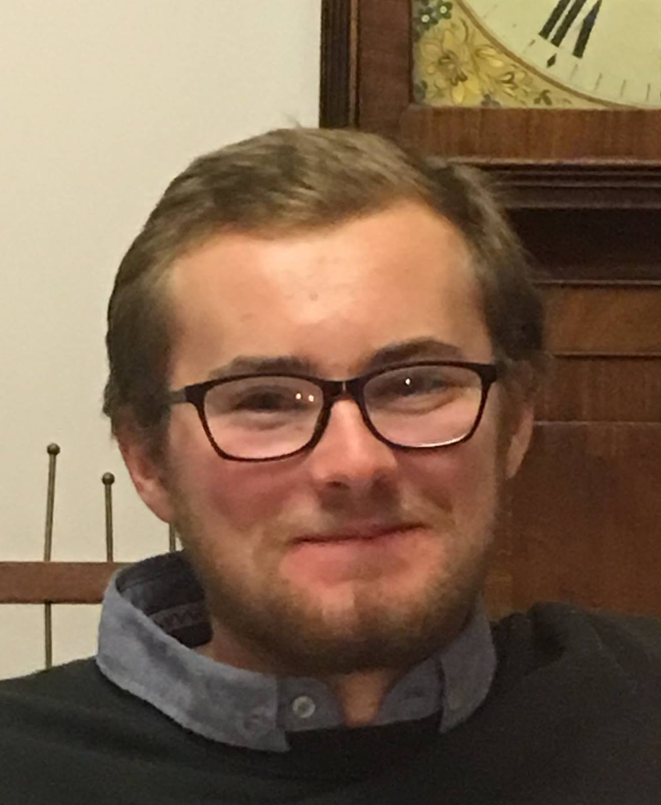
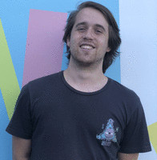

About our Team
M Alicia Hadisaputra – LoRaWan Gateway & Cloud administrator
Mona Abedi – Machine Learning & Database administrator
Liam Maguire – Frontend developer/designer
David Wisniewski – Hardware developer
Milind Rajpoot– Hardware developer

Slide 3
AGENDA
Project Overview & Solution
Reflection
Demo
Structural View
Agile Analysis
Looking to the future

Slide 4
The Problem
30 million sheep in Australia alone
Farmers have no efficient way of monitoring the health of livestock
Solutions provided so far are expensive

Slide 5
PROJECT REQUIREMENTS
Real time retrieval of data from sensors attached to animals
Retrieve data via LoRaWAN
Train data with machine learning algorithms
Store data within a database
Display data in an easy to understand manner

Slide 6
Constraints
Lack of face to face interactions
Inability to implement LoRaWAN as required
Inability to implement real time data

Slide 7
SYSTEM ARCHITECTURE

Slide 8
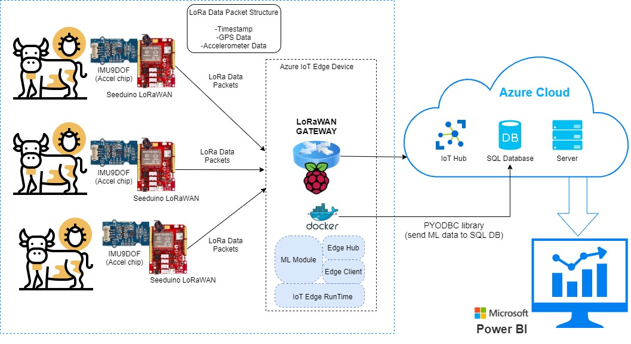
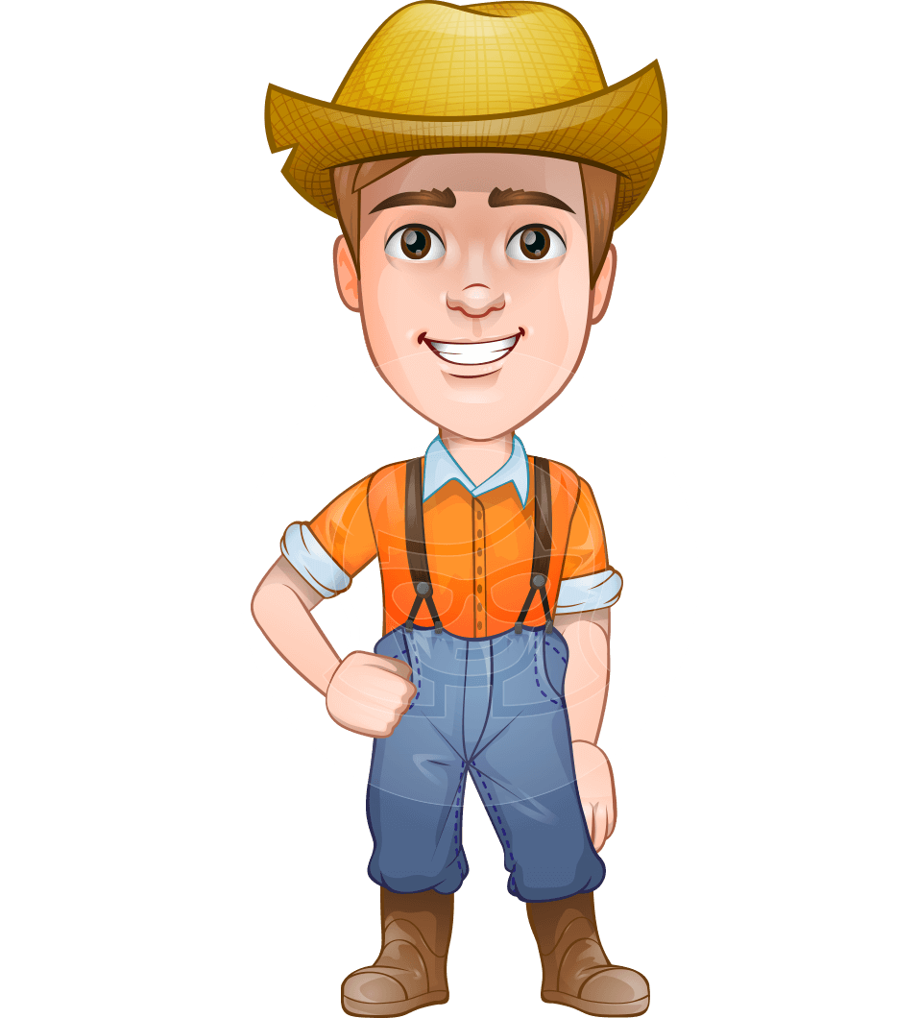
UI for primary stakeholder
Includes data like :
-Location
-Activity Status
-Health status

Slide 9
Sensor Board – Key Requirements
Interfacing and configuring LoRaWAN modem and sending LoRaWAN packets
Interfacing with sensors such as GNSS and Accelerometer
Read date and time from GPS and configure real-time clock (RTC)
Data structure for LoRaWAN packets:
Testing the prototypes in the indoor and outdoor environment
Timestamp (from GPS or RTC)
GPS Location: Longitude and Latitude
Arrays of accelerometer data for axis1, axis2 and axis3
Error Code (EC)

Slide 10
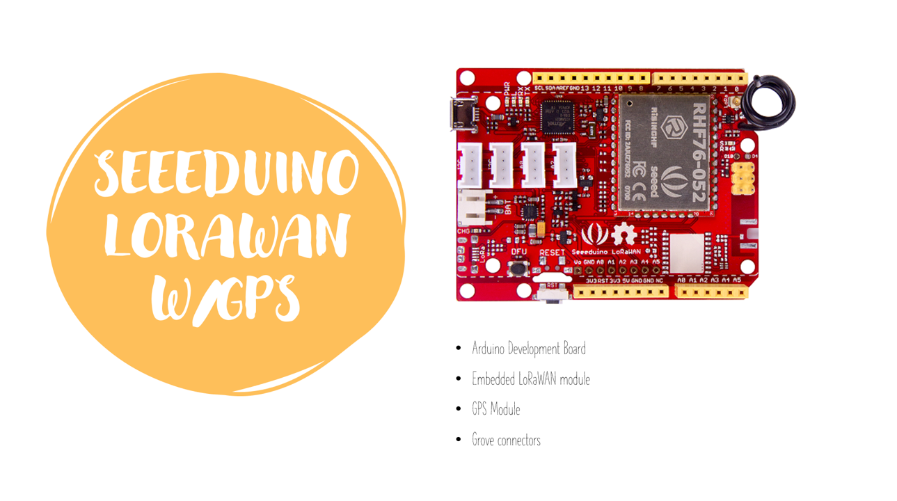

Slide 11
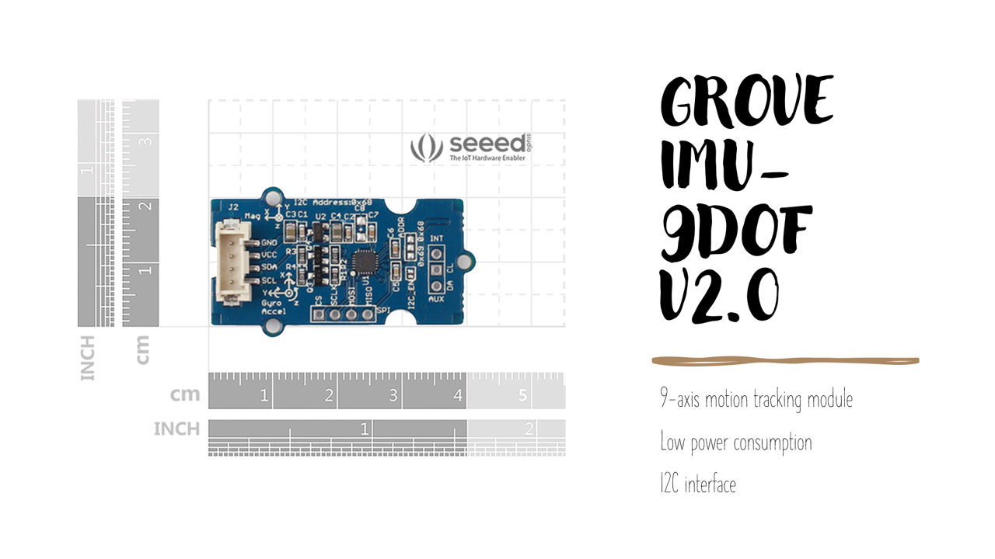

Slide 12
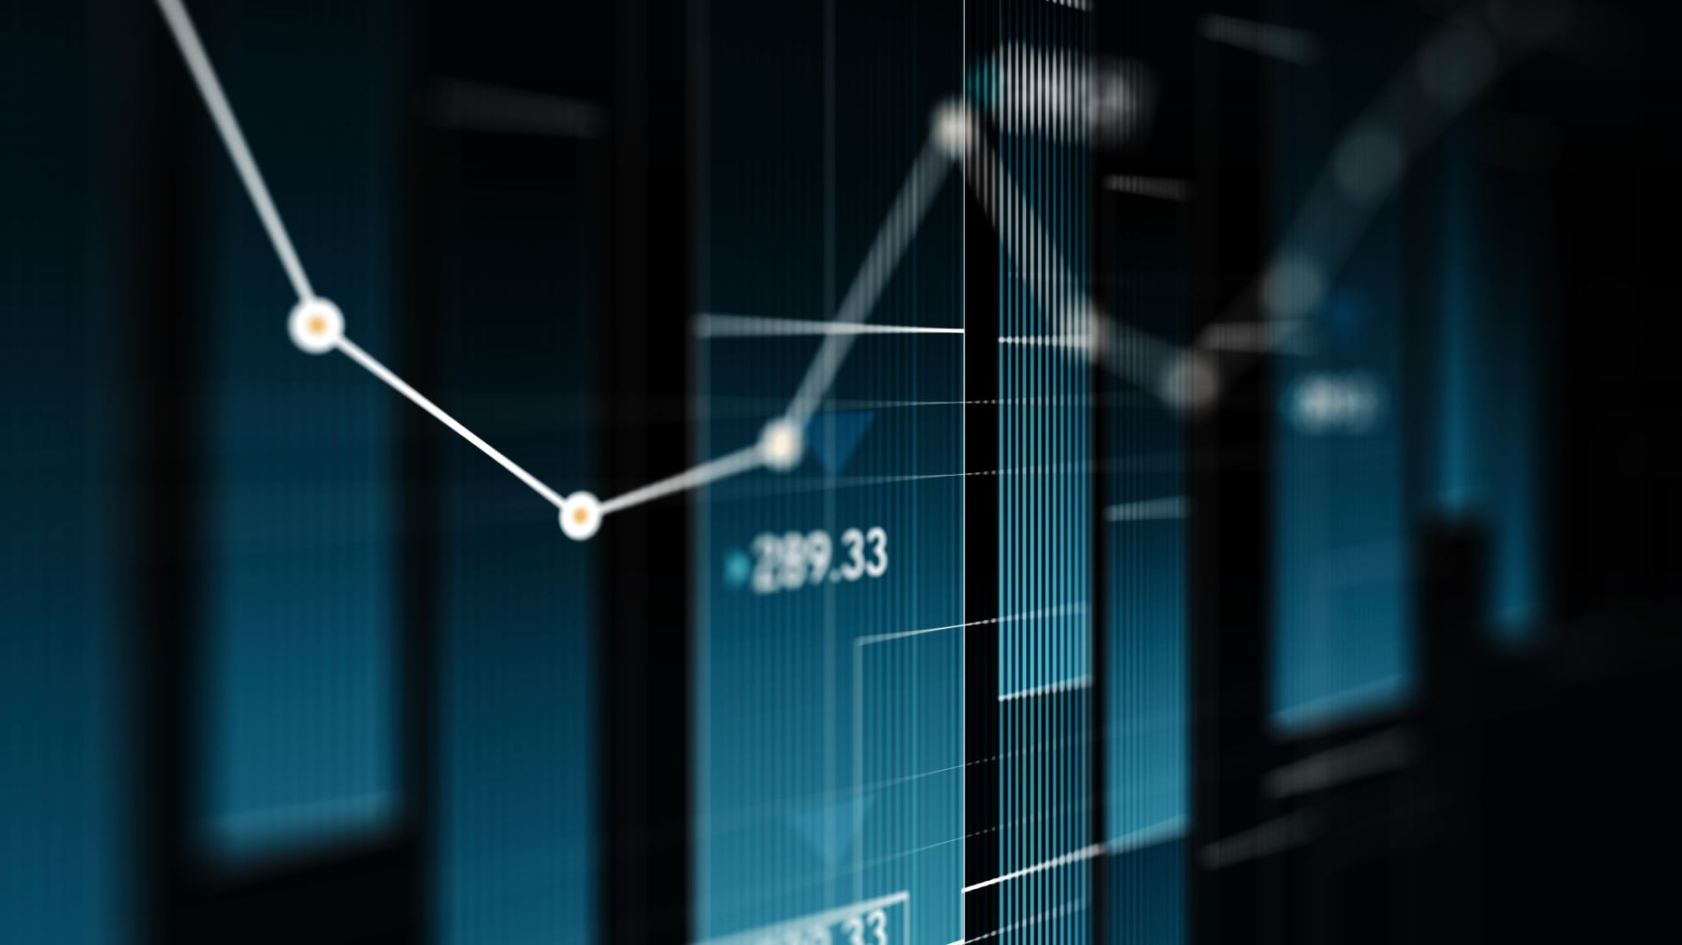
LAST PRESENTATION

Slide 13
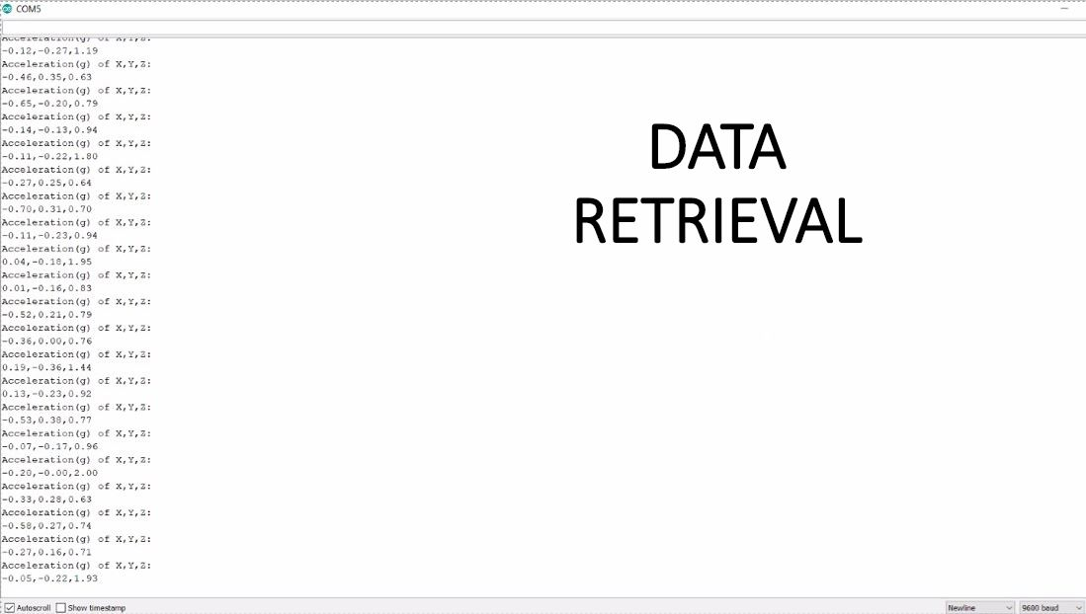
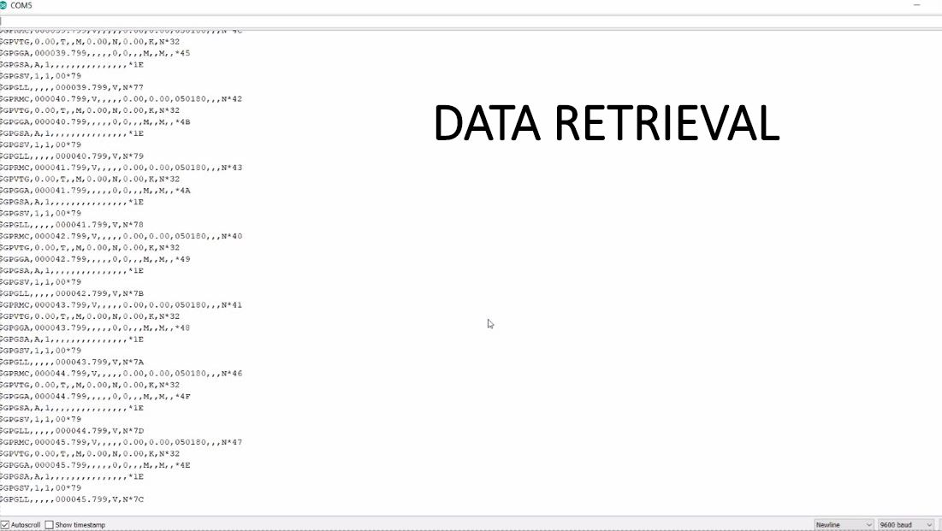

Slide 14

DATA PACKET

Slide 15
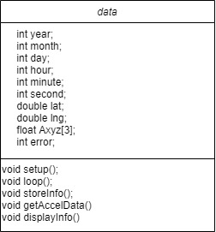
DATA PACKET UML

Slide 16
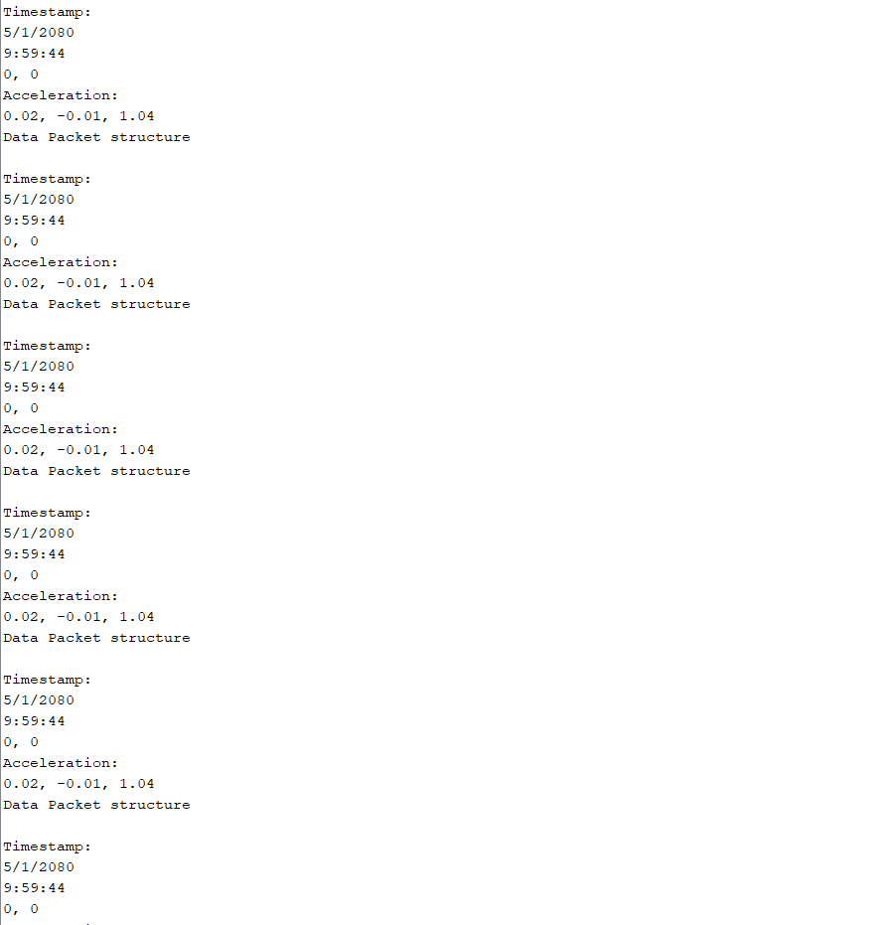
FINAL OUPUT ON SERIAL MONITOR

Slide 17
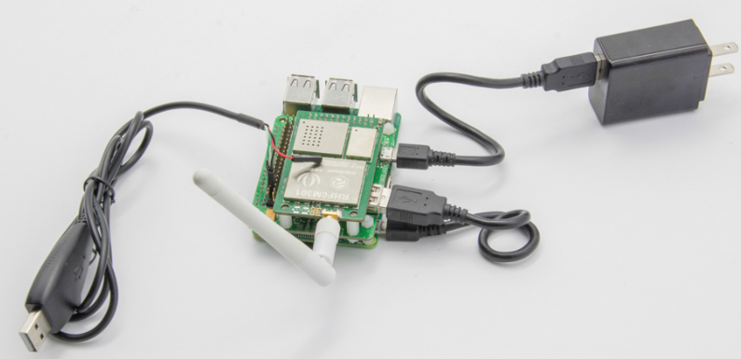
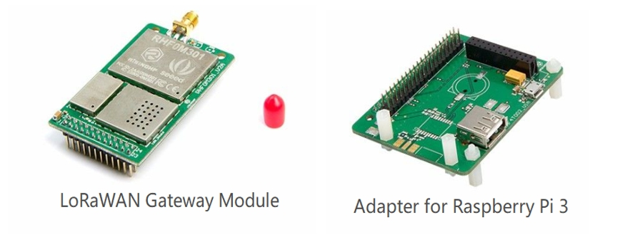
LoRaWan Gateway

Slide 18
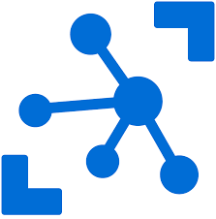
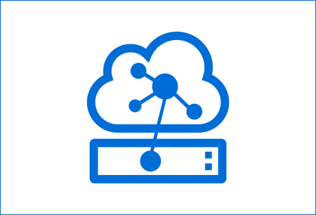
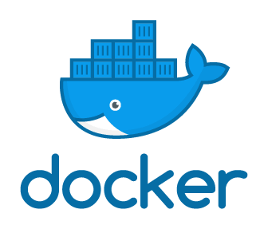
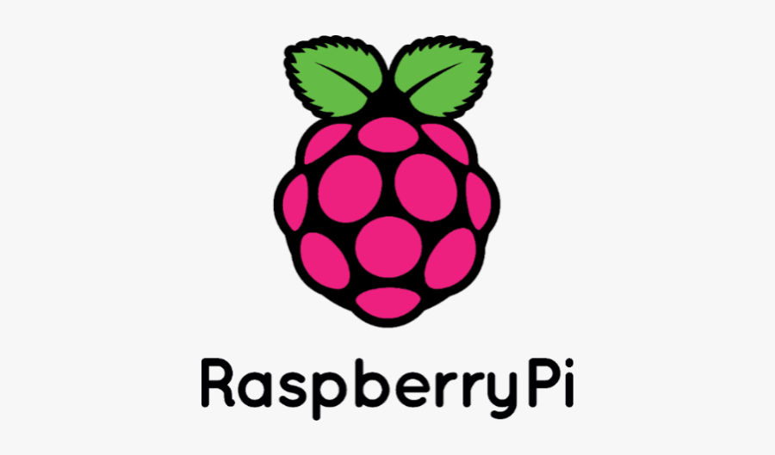
Main Technologies
IoT Edge
IoT Hub
Notes:
In our gateway, we are running azure IoT edge which is accessible from Azure IoT HUB.
As a part of IoT edge functionality, we are also using docker containers in our implementation.

Slide 19
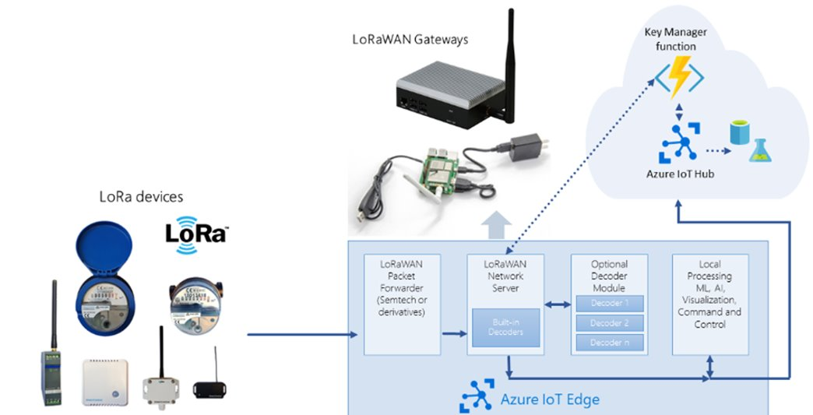
What is Azure IoT Edge?

Slide 20
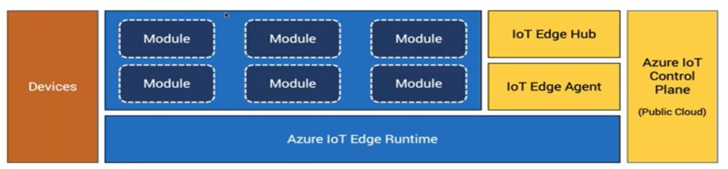
Modules we are running on the gateway:
LoRaWanNetworkServer
LoRaWanPacketForwarder
Machine Learning Model
Notes:
IoT edge are built on modules such as Edge Hub, Agent, Etc
For our project, we will need to deploy Lorawan Modules, and ML Modules.

Slide 21

IoT Edge Benefit
Reduce latency
Increased data security & Isolation
Reduce cost
Notes:
The main benefit of using azure IoT edge
--------------------------------------------------------
Firstly it reduces latency. Since data is processed locally, the information they collect doesn’t have to travel nearly as far.
Secondly, since we are processing the data locally, there is more data security. Because only necessary data is being sent to the cloud. And also as a part of integration with Docker containers,
lastly, it reduces cost as well. Because we are not using as much services on the cloud, and we are also storing less data on the cloud.

Slide 22
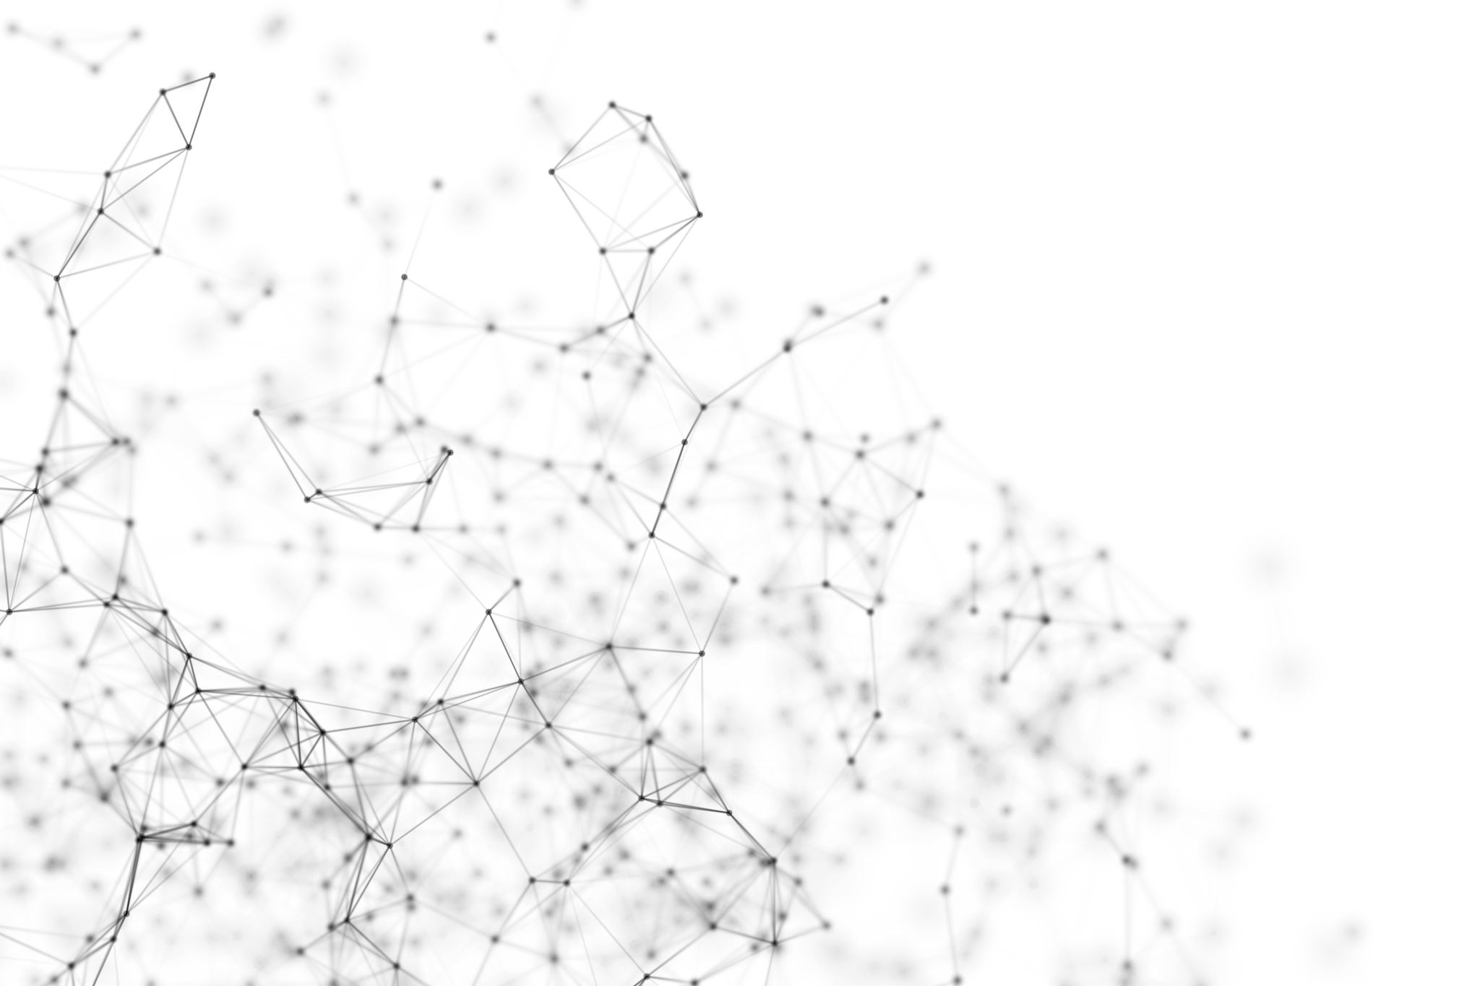
Purpose of Machine Learning:
Animals' Activities Recognition with wearable
Accelerometer Using Deep Convolutional Neural Network
Walking Rumination
Animal Activity
Grazing
Walking
Rumination
Idle
Licking

Slide 23
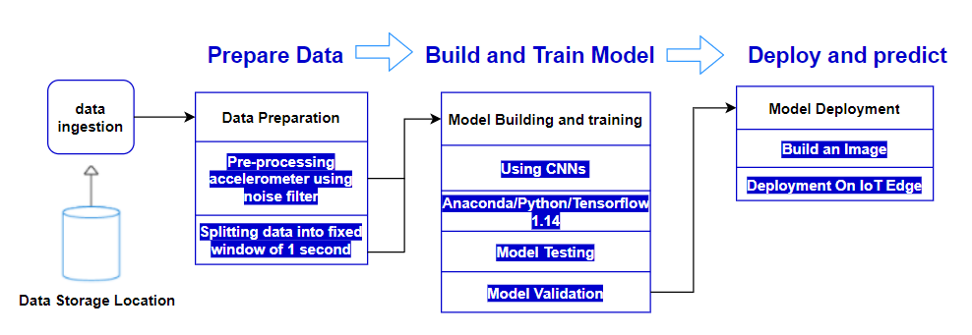
Machine Learning Process Flow

Slide 24
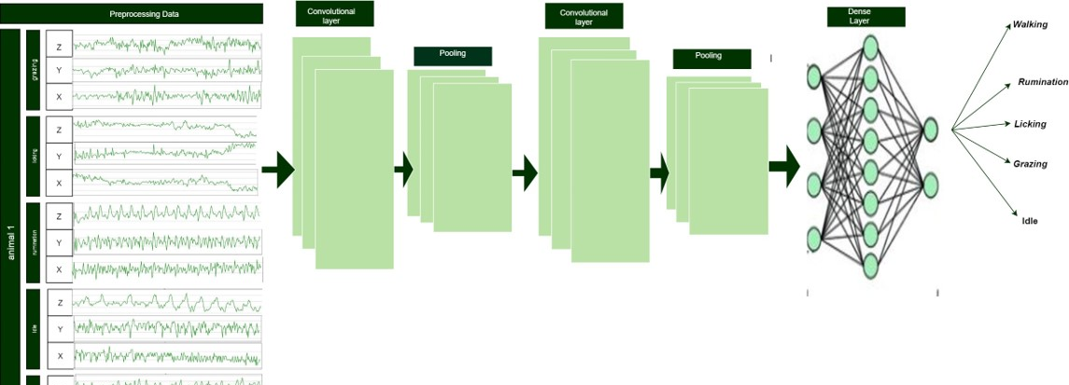
Why CNNs?
Architecture
Convolutional Layers
Pooling Layers
Fully Connected Layers
CNNS can automatically learn features from the raw sensor data
CNNs are well known to capture local dependency

Slide 25

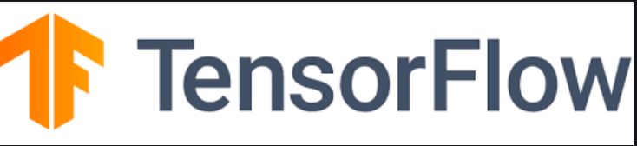
Train the Model
To build our model with Python, we use Anaconda Navigator.
Anaconda provides an efficient and easy way to install Python modules on our machine
TensorFlow 1.14

Slide 26
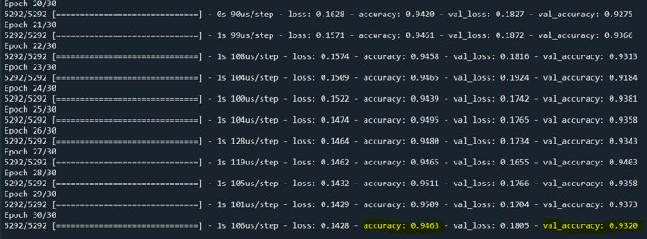
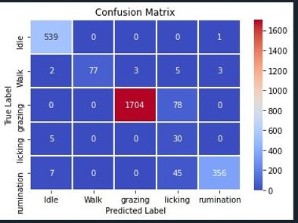
Test the Model​
​
Cross validation test​
Confusion Matrix

Slide 27
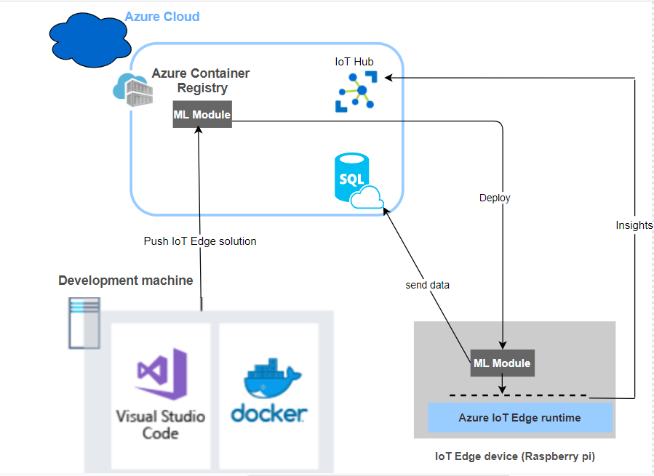
Implementation and Deployment On IoT Edge
Vs Code
PYODBC
FreeTDS

Slide 28
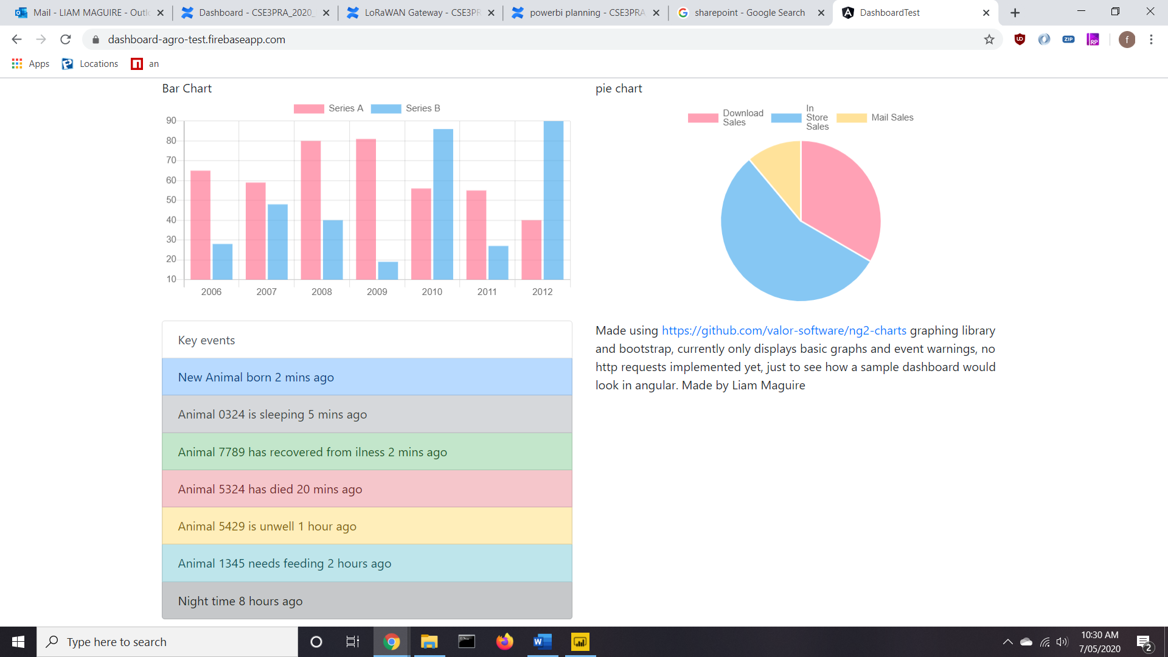
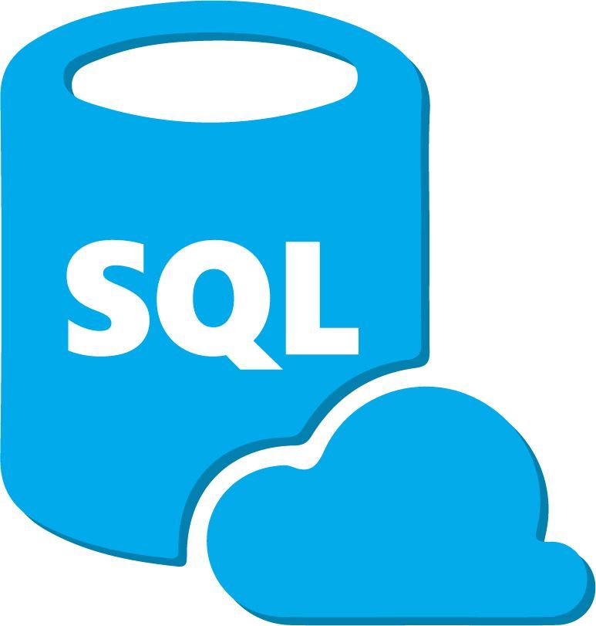
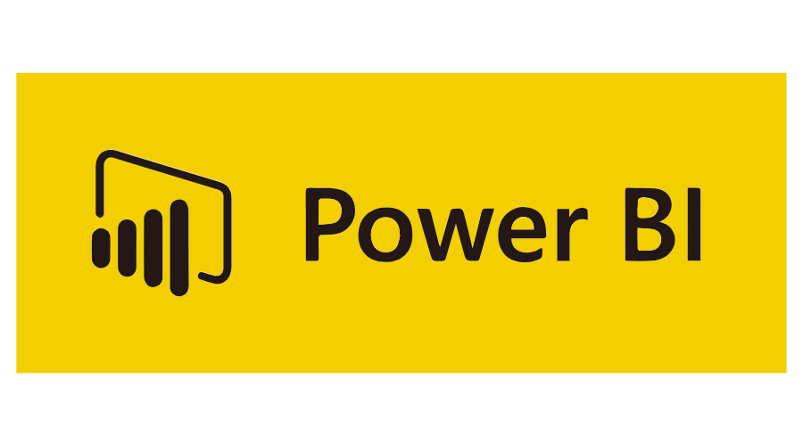
LoRaWan Gateway
Power BI
DashBoard

Slide 29
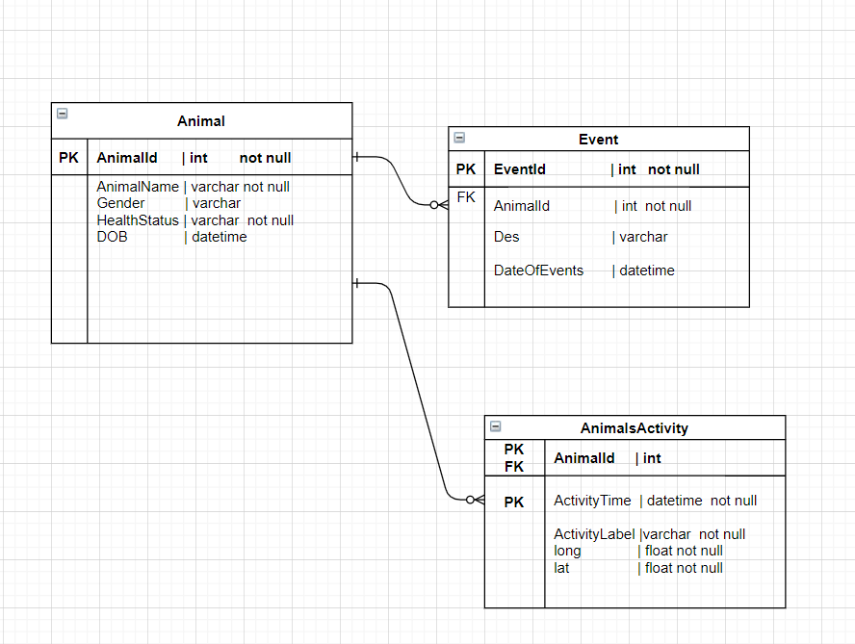

Slide 30
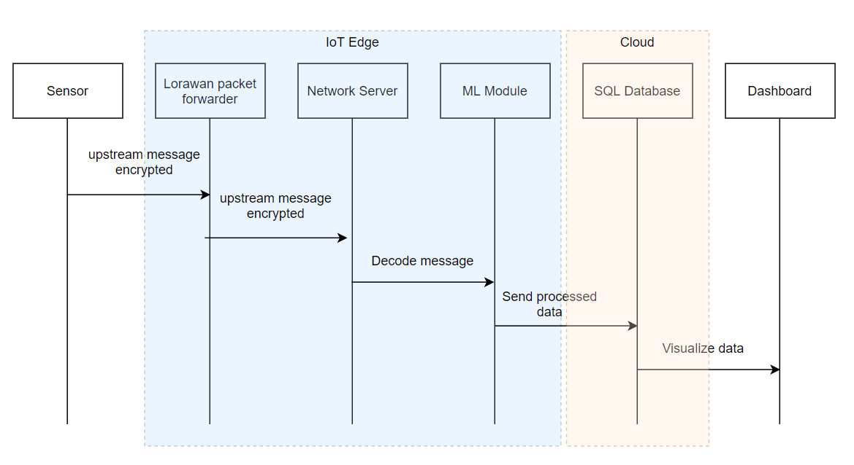
Notes:
This demo starts with sensor collecting raw data and sending the data via LoraWan connection.
So the encrypted upstream msg sent from the lora device, received and forwarded by the pktfwd/loraconcentrator to the Network Server.
There, it recognizes the network session key then validate, decrypt and decode the message.
Then the data is received by ML Module, where data is processed and sent to the sql database
At the end of the demo, we should be able to see the processed data visualized in the dashboard.

Slide 31
Demo

Slide 32
System Testing
The Goal
Functionality of ML Algorithm
Testing
Empty Database
power off Gateway
Push Algorithm to Edge
Expectations
Database filled
Visual representation on Dashboard

Slide 33

USABILITY AND TESTING
USER SURVEY
USABILITY TESTING
SYSTEM USABILITY SCALE
REVIEW

Slide 34
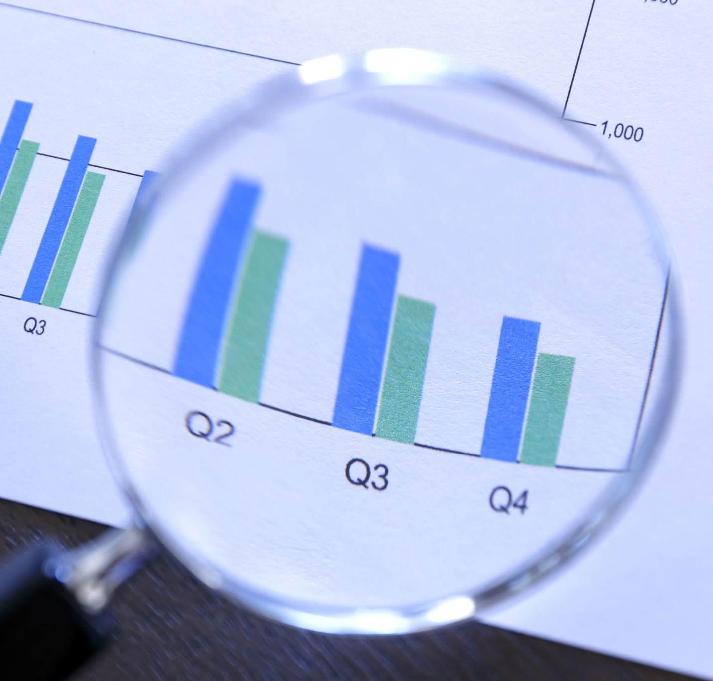
The results
Testing for User Interface Satisfaction
High level of success
Improvements

Slide 35
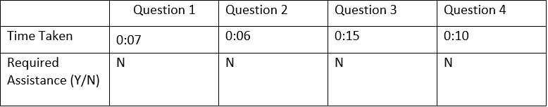
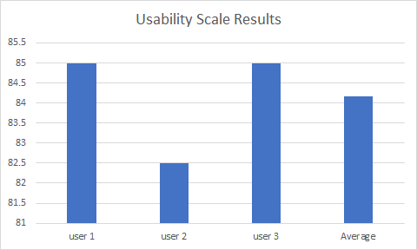
The results cont.

Slide 36
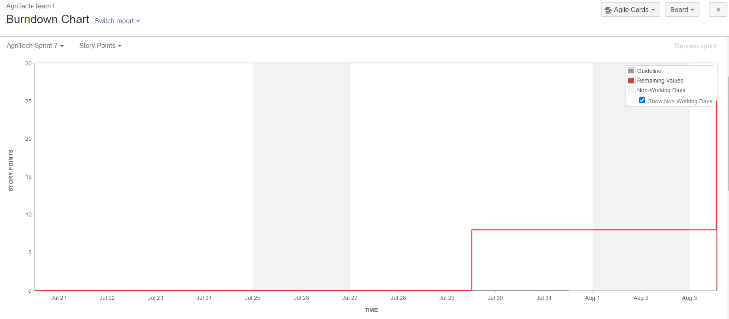
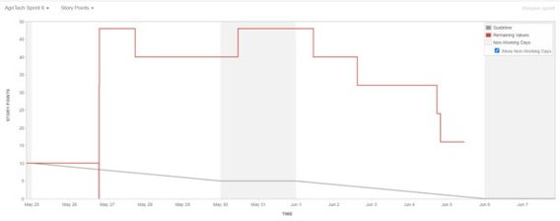
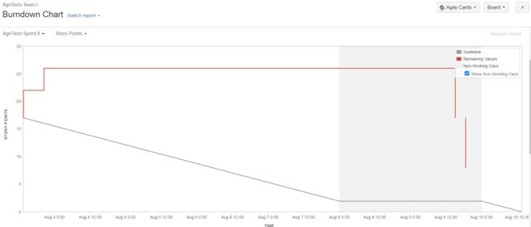
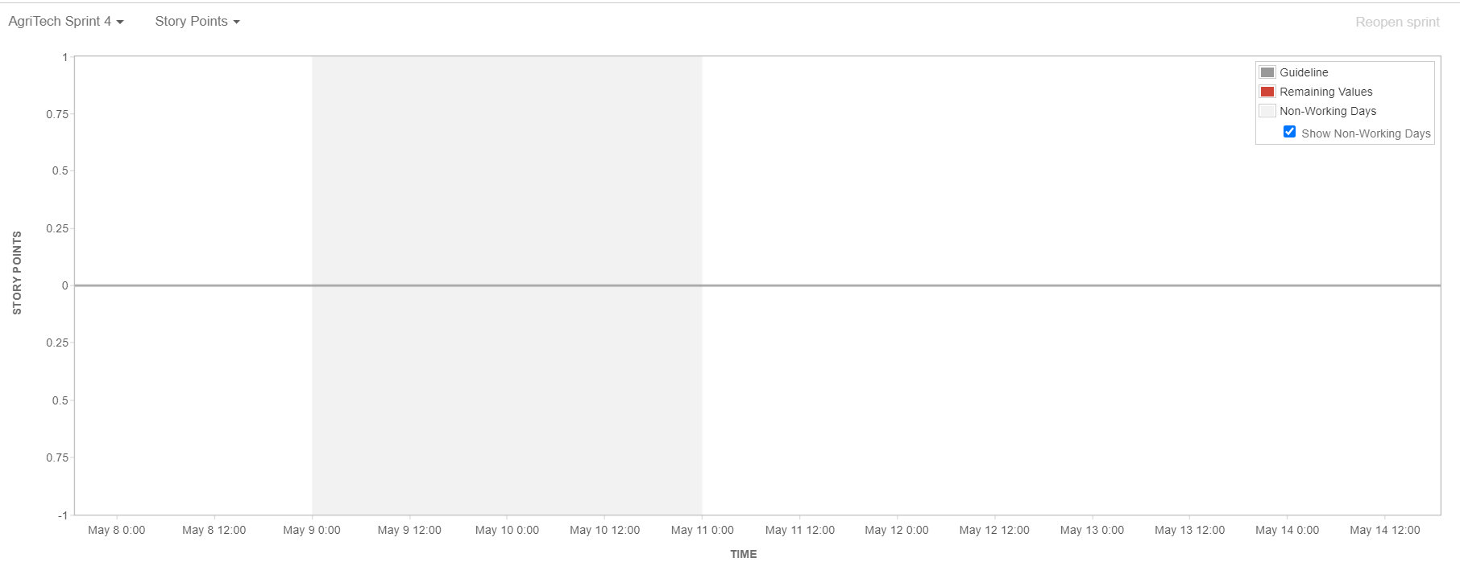
Improvements
Last Semester
Latest Sprints

Slide 37
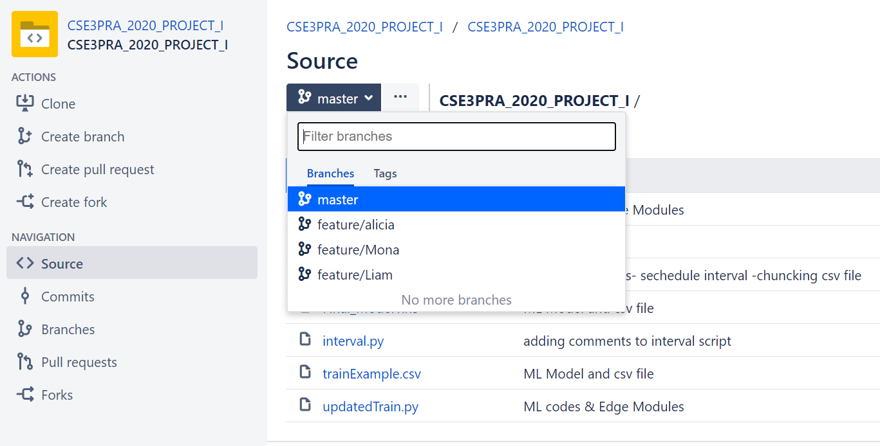
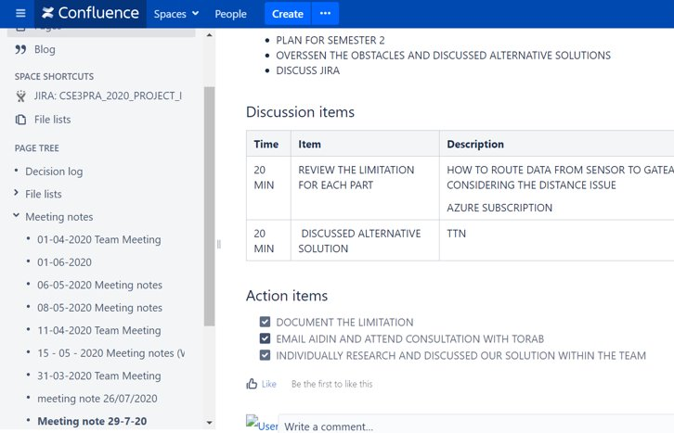
Project Management tools:
Bitbucket
Confluence

Slide 38
Looking to the Future
Connection via LoRaWAN

Slide 39


Q & A

